Slide 1
IETF Hackathon
IETF 105
20-21 July 2019
Montreal

Slide 2
Welcome
First IETF event?
First IETF Hackathon?
Not attending IETF meeting?

Slide 3
Why Are We Here
Advance pace and relevance of IETF standards
Bring speed and collaborative spirit of open source software into the IETF
Flush out ideas, feed into WG session
Produce sample code/reference implementations, utilities
Attract developers, young people to IETF
Match young, skillful developers with IETF veterans
University engagement around hackathon projects

Slide 4
Note Well
This is a reminder of IETF policies in effect on various topics such as patents or code of conduct. It is only meant to point you in the right direction. Exceptions may apply. The IETF's patent policy and the definition of an IETF "contribution" and "participation" are set forth in BCP 79; please read it carefully.
As a reminder:
By participating in the IETF, you agree to follow IETF processes and policies.
If you are aware that any IETF contribution is covered by patents or patent applications that are owned or controlled by you or your sponsor, you must disclose that fact, or not participate in the discussion.
As a participant in or attendee to any IETF activity you acknowledge that written, audio, video, and photographic records of meetings may be made public.
Personal information that you provide to IETF will be handled in accordance with the IETF Privacy Statement.
As a participant or attendee, you agree to work respectfully with other participants; please contact the ombudsteam (https://www.ietf.org/contact/ombudsteam/) if you have questions or concerns about this.
Definitive information is in the documents listed below and other IETF BCPs. For advice, please talk to WG chairs or ADs:
BCP 9 (Internet Standards Process)
BCP 25 (Working Group processes)
BCP 25 (Anti-Harassment Procedures)
BCP 54 (Code of Conduct)
BCP 78 (Copyright)
BCP 79 (Patents, Participation)
https://www.ietf.org/privacy-policy/ (Privacy Policy)

Slide 5
IPR and Code Contribution Guideline
Hackathon participants free to work on any code
Rules regarding that code are what each participant's organization and/or open source project says they are
The code itself is NOT an IETF contribution
Discussions, presentations, and demos done as part of the hackathon are the same type of IETF contributions as those made in working groups; therefore, the usual IETF copyright and/or IPR disclosure rules apply

Slide 6
Agenda - Saturday
08:30: Room open for setup by project champions
09:00: Room open for all - Pastries and coffee provided
09:30: Hackathon kickoff (​Join via Meetecho)
09:45: Form Teams
12:30: Lunch provided
15:30: Afternoon break - Snacks provided
19:00: Dinner provided
22:00: Room closes

Slide 7
Agenda - Sunday
08:30: Room opens - Pastries and coffee provided
12:30: Lunch provided
13:30: Hacking stops, prepare brief presentation of project
14:00: Project presentations to other participants ​
(Join via Meetecho)
15:45: Closing remarks and opportunities for next time
16:00: Hackathon ends
17:00: Tear down complete

Slide 8
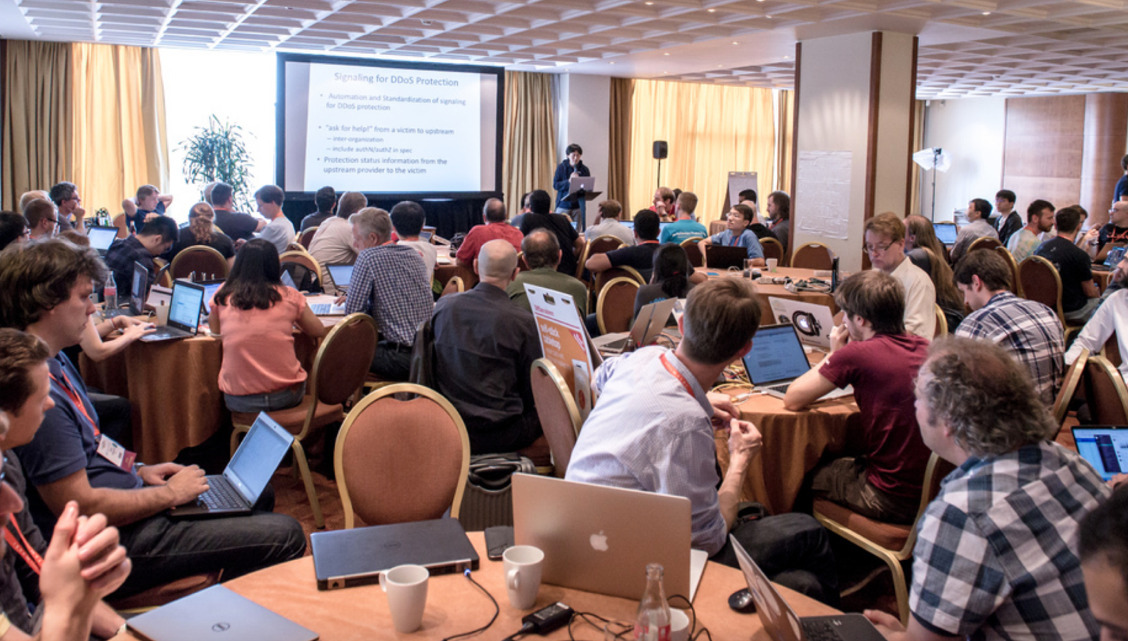
Project Presentations
What problem you tried to solve?
What you achieved?
Highlights
Lessons learned
Feedback to work group
Open source, other SDOs
3 minute max

Slide 9
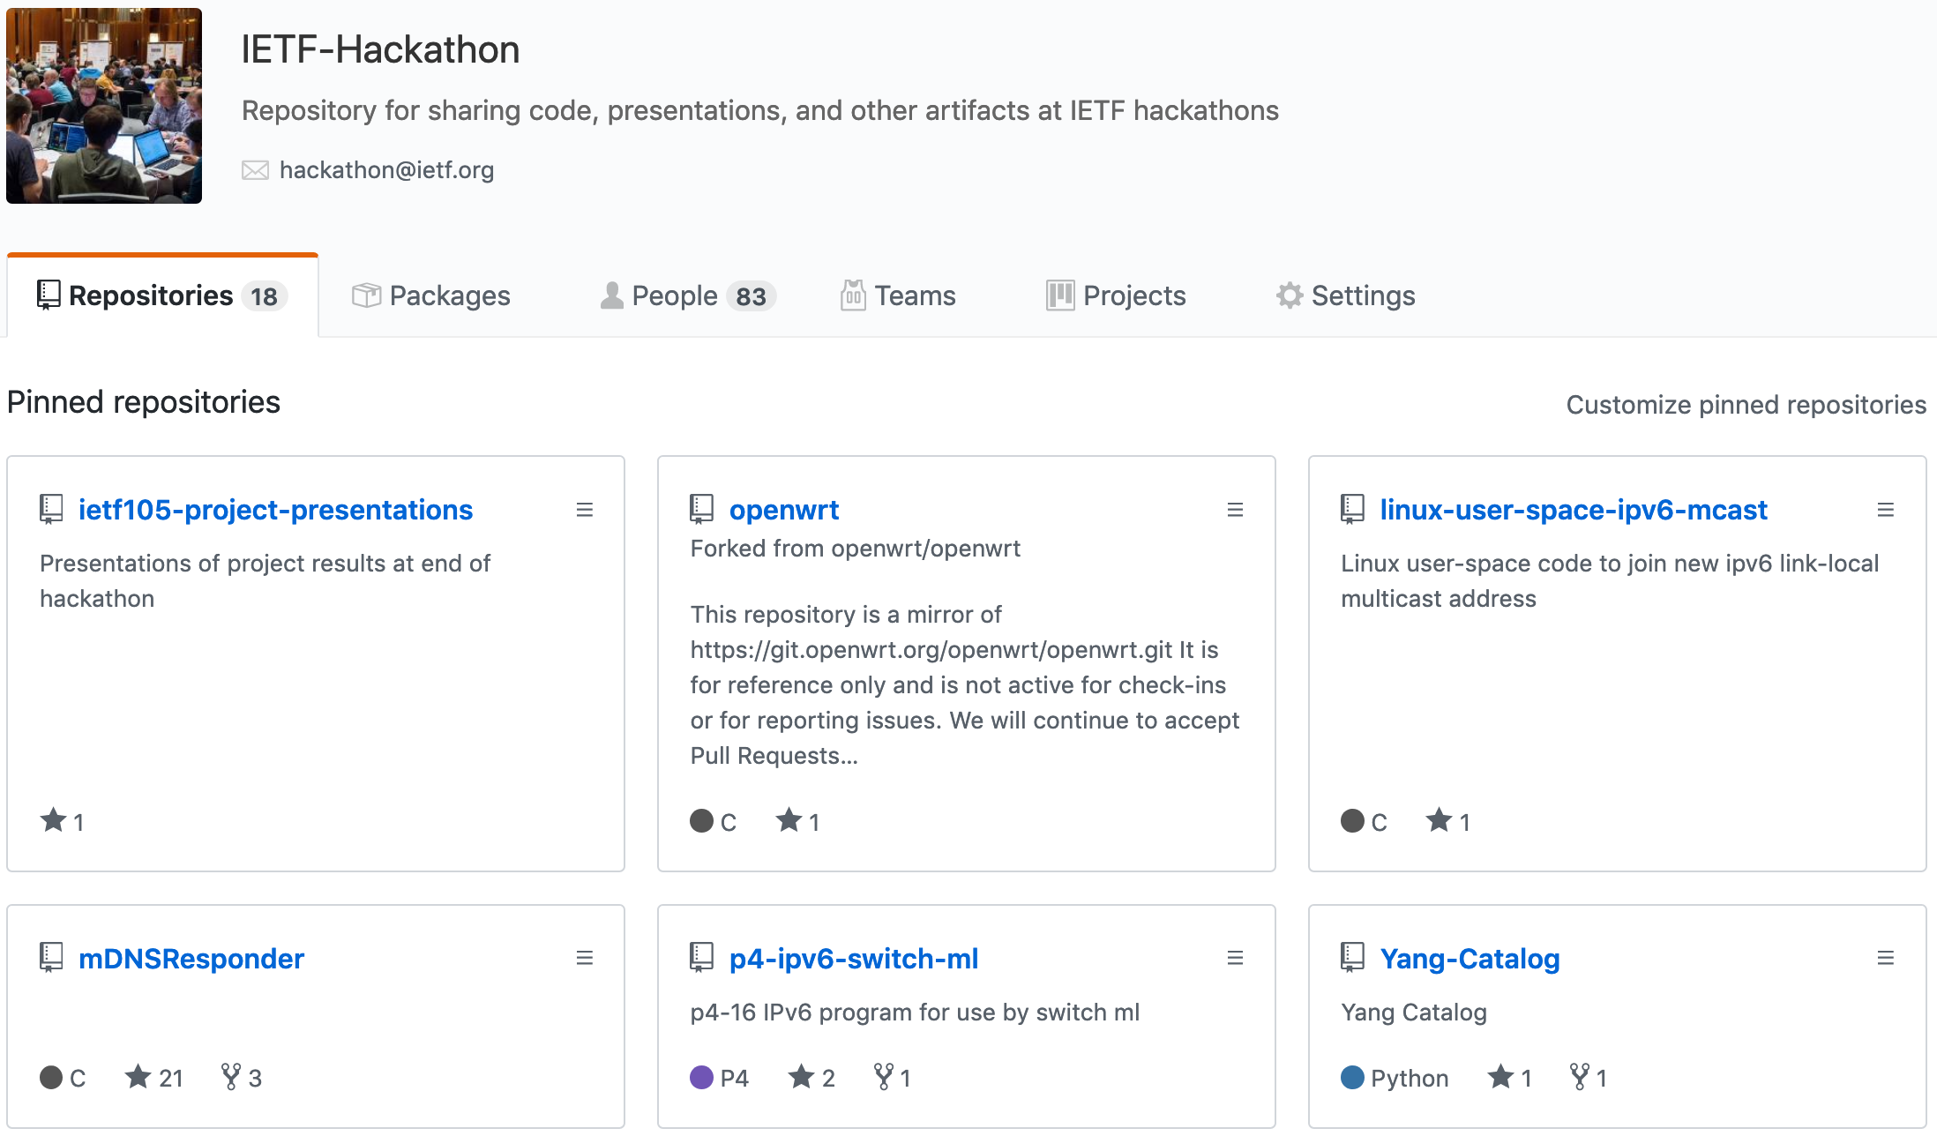
https://github.com/ietf-hackathon

Slide 10
https://github.com/ietf-hackathon

Slide 11
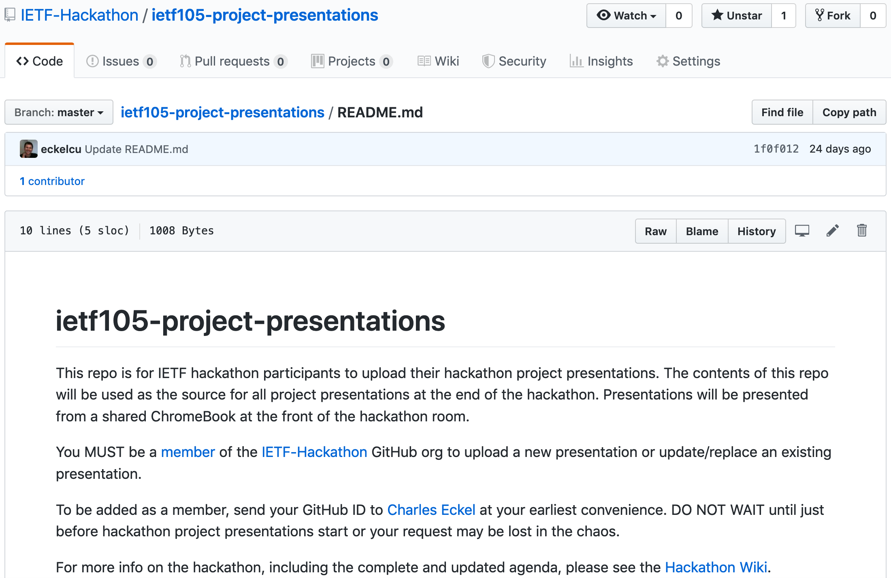

Slide 12
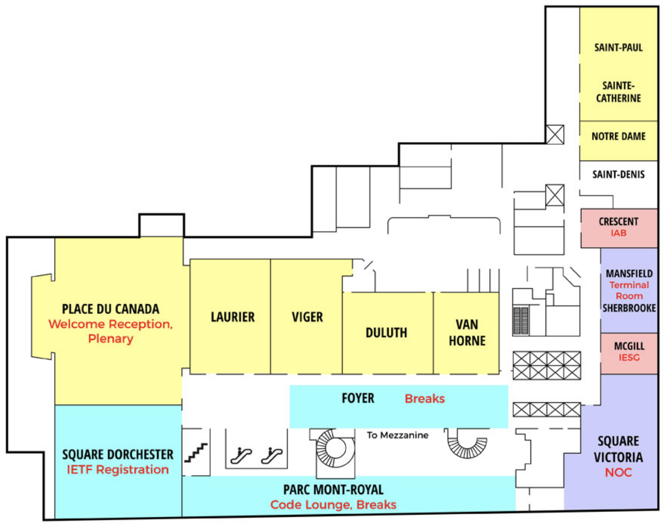
Hackdemo Happy Hour 2nd Floor, Parc Mont-Royal
Share hackathon projects with IETF Community
Monday 18:10 - 19:40
Register your team
MUST REGISTER BY 1200 MONDAY

Slide 13
Code Lounge 2nd Floor, Parc Mont-Royal
Space reserved in lounge all week
Collaborate on running code
Schedule time for your team

Slide 14



THANK YOU!

Slide 15
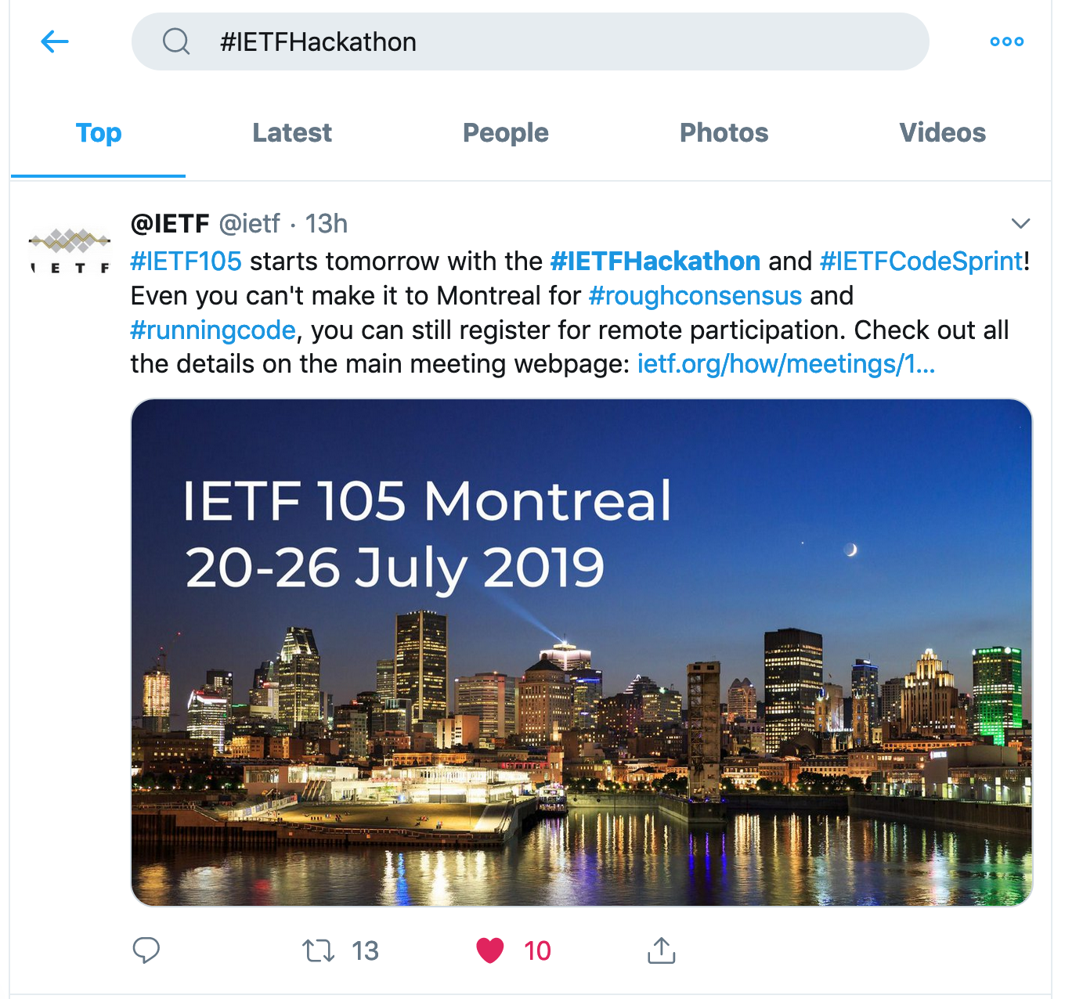
Spread the News
Post to Twitter
#IETFHackathon
#IETF105

Slide 16

Questions?

Slide 17
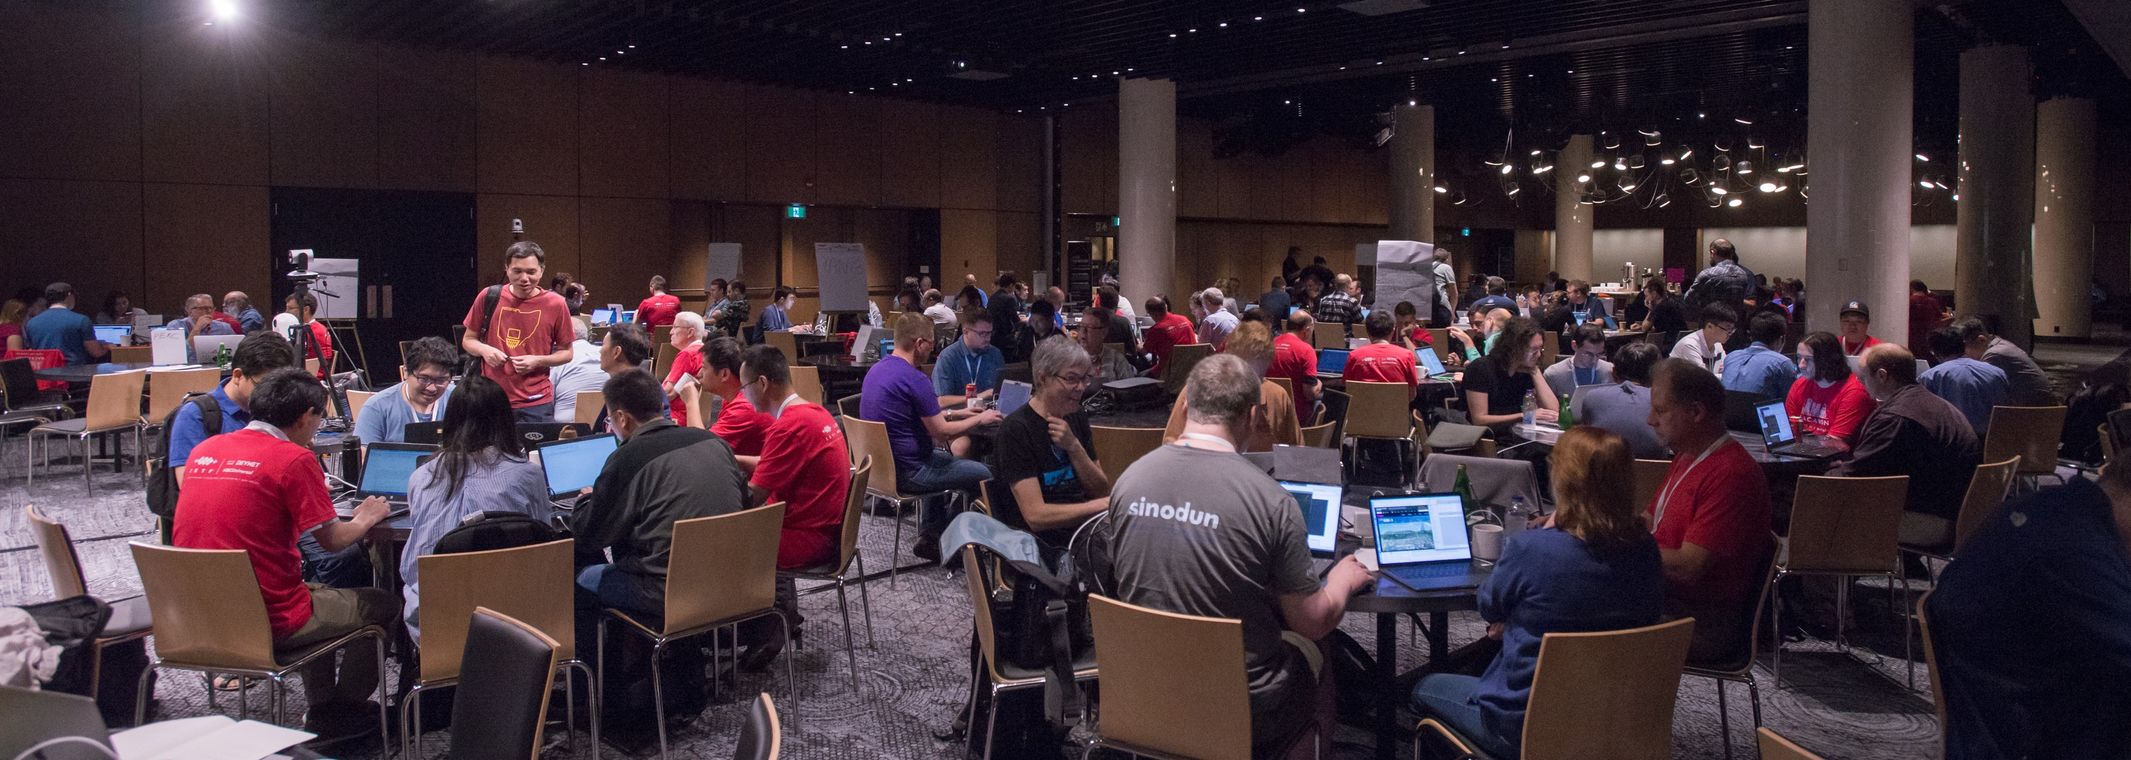
Let’s Start Coding!

